Slide 1
Corprate Culture
Desired Organizational Culture

Slide 2

Teamwork Culture
Notes:
Source: Great Place To Work, Lori Casselman (2017)

Slide 3
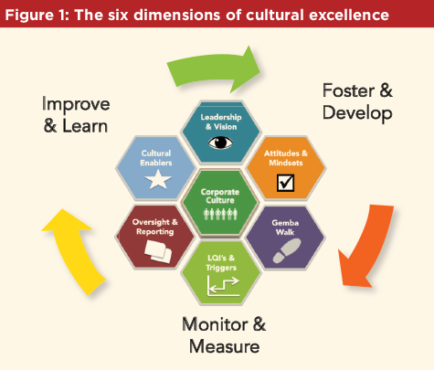
People, Finances, Policies, and Corporate Policies
Notes:
Source: ISPE, Erika Ballman (2017)

Slide 4
References
Casselman, L. (2017). Trust me. It’s all about
corporate culture. Great Place to work.
Retrieved from
https://www.greatplacetowork.ca/en/reso urces/articles/460-trust-me-it-s-all-about -corporate- culture
Ballman, E. (2017). How leader actions and
behaviors influence quality culture.
Retrieved from
https://ispe.org/pharmaceutical- engineering/ispeak/how-leader-actions-and- behaviors-influence-quality-culture

